Slide 1
Exploring the impact of lifestyle quality of sleep
Rohan Uttam Khapane 3147 M.sc. D.a.

Slide 2
Problem statements
Which factors have an association with the quality of sleep ?
Which factors have an association with the sleep duration ?
With changes, does age groups have different sleep duration ?
Does stress level have an impact on sleep duration ?
Sleep duration changes according to gender?

Slide 3
Data Understanding
Discrete
Age
Number of time you wake up during the night
Nominal
Gender
Regular Meal Schedule
Ordinal
Quality of Sleep
Profession
Work Schedule
Sleep Disorder
Use of Electronic device before bed
Consumption of caffeine before bed
Consumption of heavy meal close to bedtime
Bed time routine
Sleep Duration (in hours)
Emotional state before sleep
Naps during the day
Stress levels
Frequency of caffeine before sleep
Dietary habits
Frequency of Physical Activity / Excercise

Slide 4
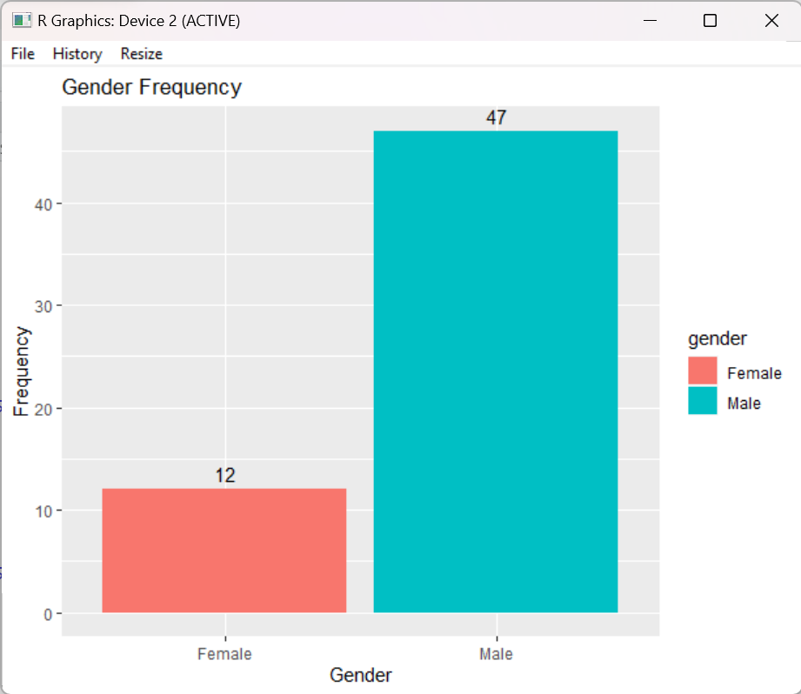
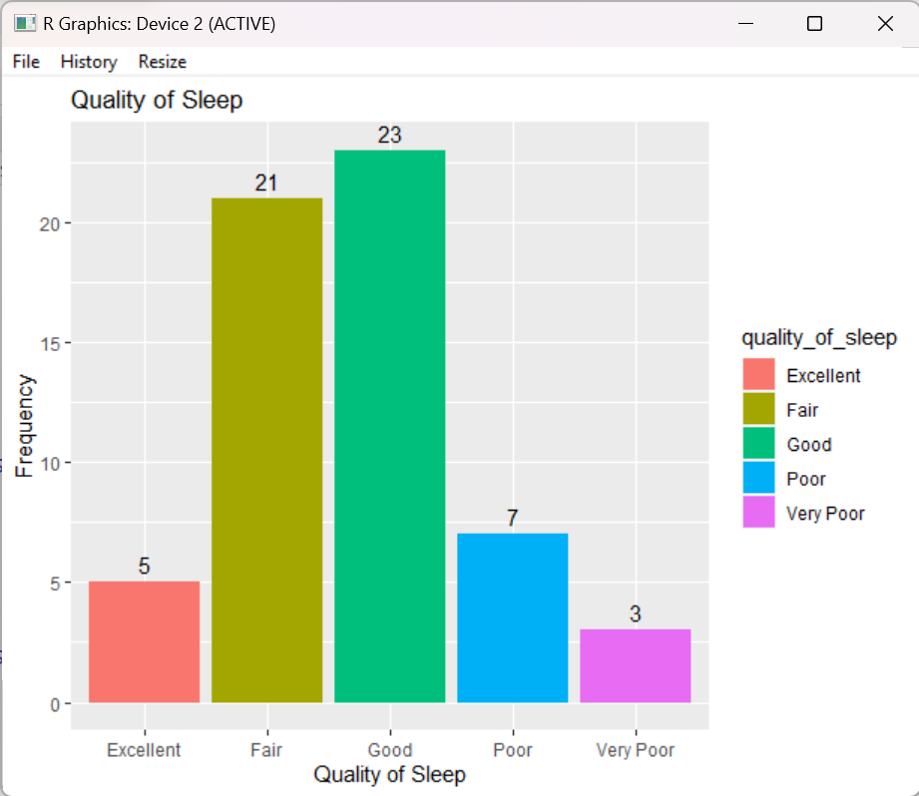
Data Visualization

Slide 5
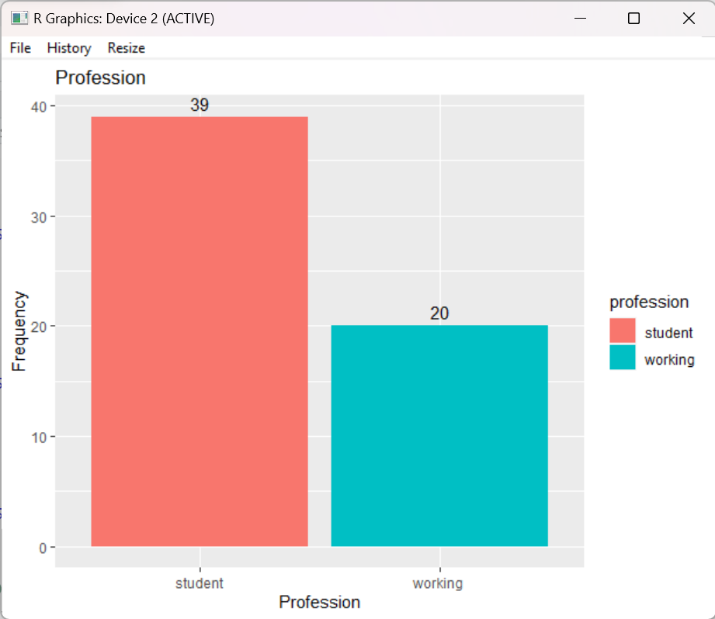
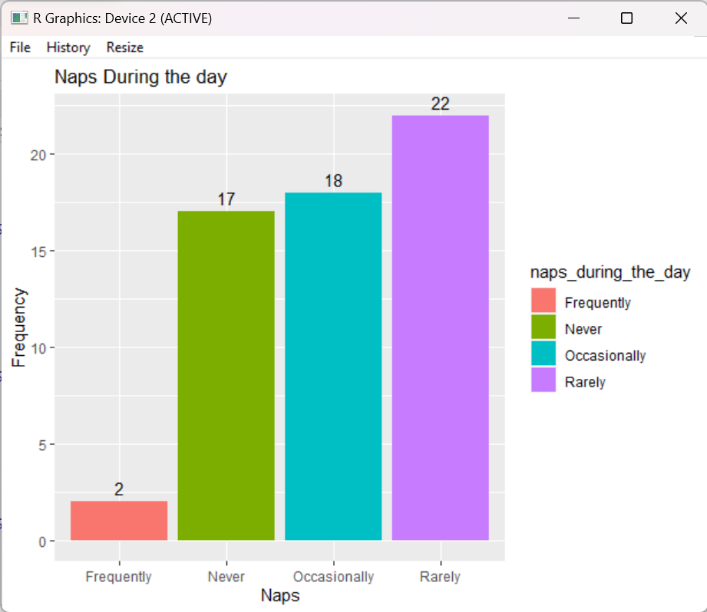
Data Visualization

Slide 6
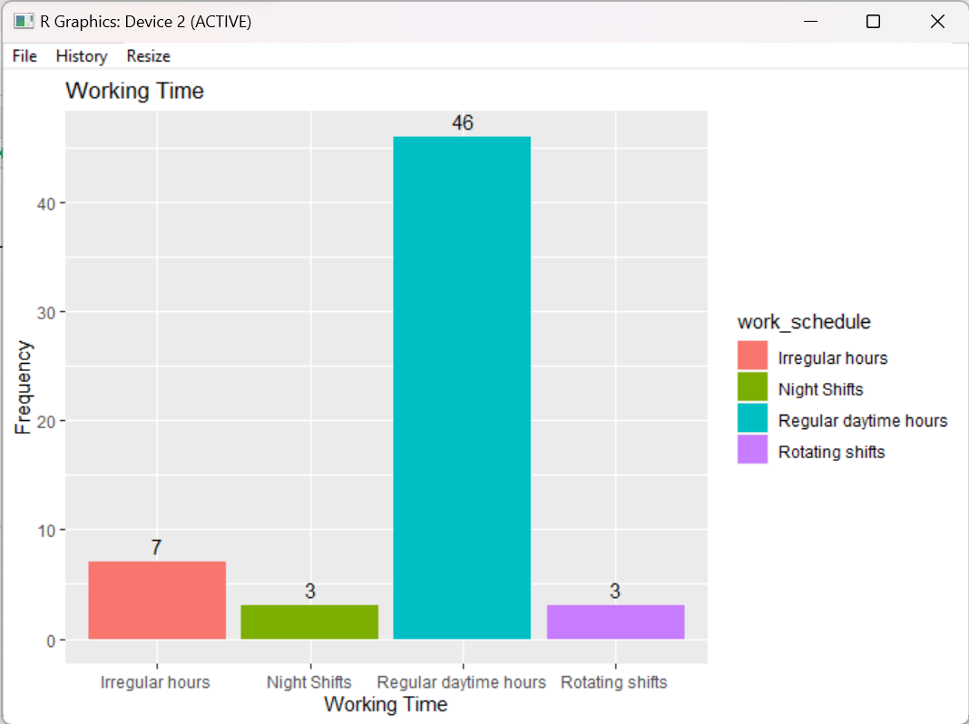
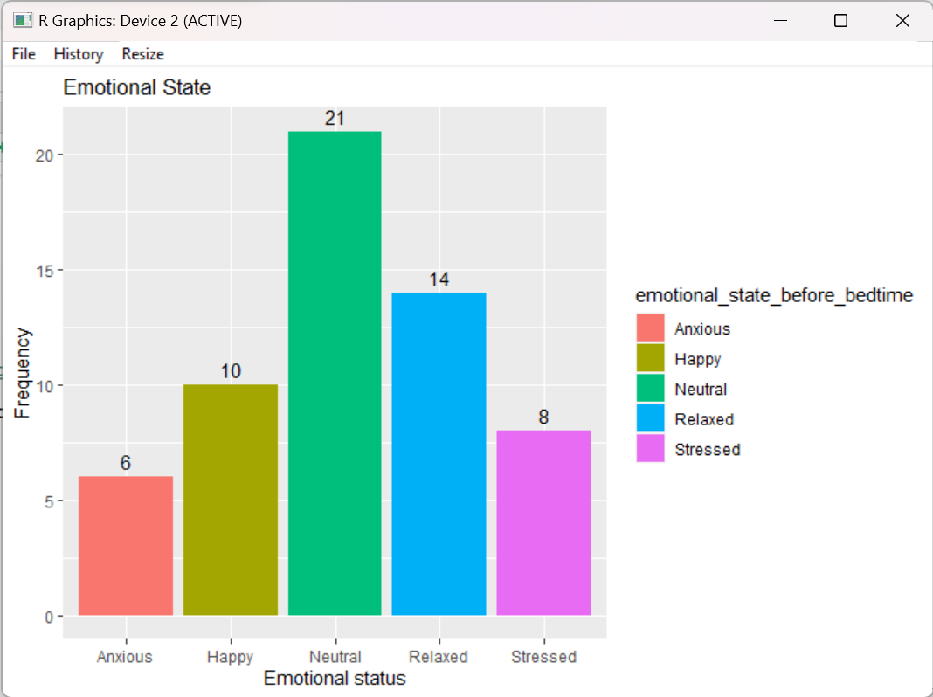
Data Visualization

Slide 7
HYPOTHESIS Testing
Shapiro-Wilk Test
Fisher's Exact Test
Kruskal-Wallis Test
Mann-Whitney U Test

Slide 8
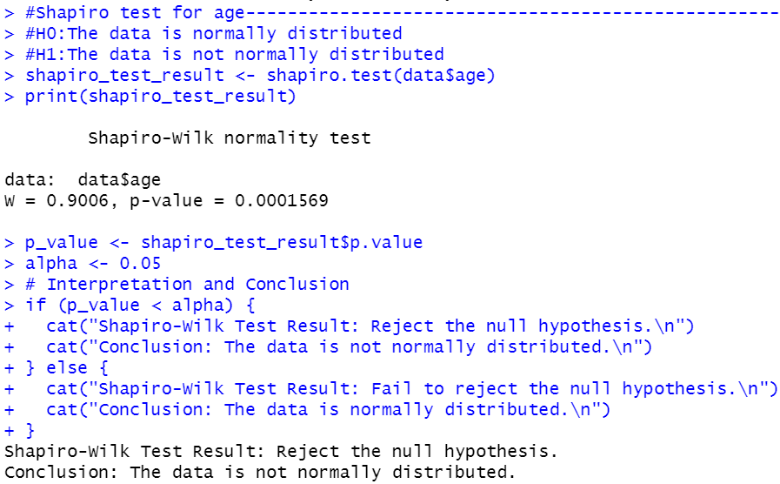
Shapiro-Wilk Test
Null Hypothesis : The data$age is normally distributed.
Alternate Hypothesis :The data$age is not normally distributed.
LOS = 5%
P-value < 0.05 ( i.e 0.0001569< 0.05) We, reject null hypothesis.
Conclusion: The data$age is not normally distributed.
Therefore, All the test performed using age will be non parametric test

Slide 9
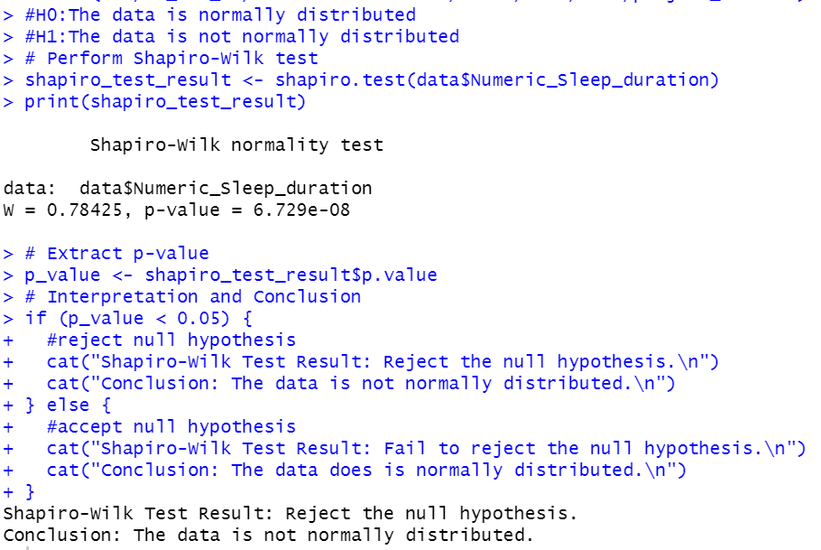
Shapiro-Wilk Test
Null Hypothesis: The data$Numeric_Sleep_duration is normally distributed.
Alternate Hypothesis :The data$Numeric_Sleep_duration is not normally distributed.
LOS = 5%
P-value < 0.05 ( i.e 6.729e-08 < 0.05) We, reject null hypothesis.
Conclusion: The data$Numeric_Sleep_duration is not normally distributed.
Therefore, All the test performed using Numeric_sleep_duration will be non parametric test

Slide 10
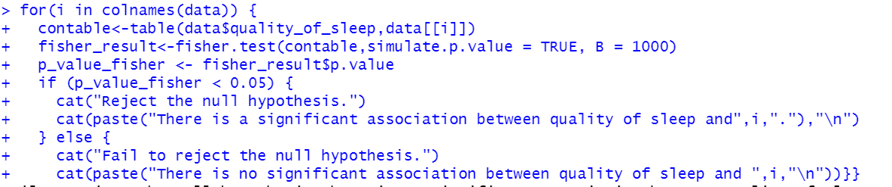
Fisher's Exact Test
Null Hypothesis : There is no association between the Quality of Sleep and other variables.
Alternate Hypothesis :There is an association between the Quality of Sleep and other variables.
LOS = 5%
P-value < 0.05 We, reject null hypothesis.
Conclusion: There is an association between the Quality of Sleep and other variables.

Slide 11
Factor’s having an association with quality of sleep
Association with Quality of sleep
Frequency of wake up during the night
Disassociation with Quality of sleep
Age
Sleep duration
Sleep disorder
Caffeine before sleep
Emotional state before bedtime
Work schedule
Gender
Profession
Exercise
Stress levels
Use of electronic device before bed
Frequency of caffeine consumption before sleep
Consistent bedtime routine
Dietary habits
Consumption of heavy meals before sleep
Regular meal schedule
Naps during the day

Slide 12
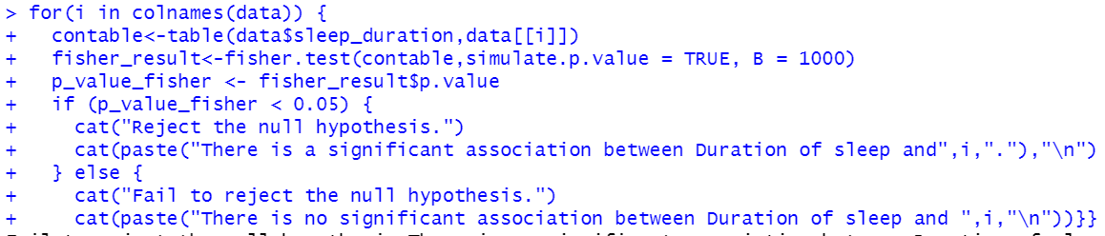
Fisher's Exact Test
Null Hypothesis : There is no association between the Sleep Duration and other variables.
Alternate Hypothesis :There is an association between the Sleep Duration and other variables.
LOS = 5%
P-value < 0.05 We, reject null hypothesis.
Conclusion: There is an association between the Sleep Duration and other variables.

Slide 13
Factor’s having an association with sleep Duration
Association with Sleep Duration
Frequency of wake up during the night
Disassociation with Sleep Duration
Age
Sleep disorder
Caffeine before sleep
Gender
Profession
Exercise
Use of electronic device before bed
Dietary habits
Consumption of heavy meals before sleep
Regular meal schedule
Naps during the day
Quality of sleep
Stress levels
Frequency of caffeine consumption before sleep
Consistent bedtime routine
Emotional state before bedtime
Work schedule

Slide 14
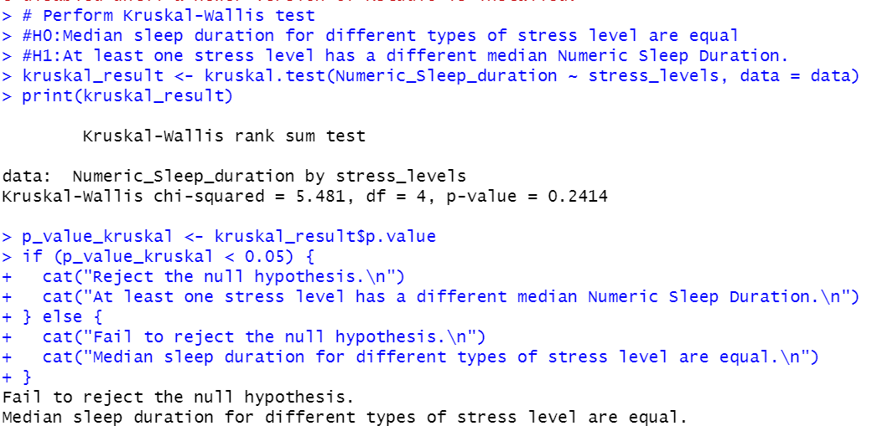
Kruskal-Wallis Test
Null Hypothesis : Median sleep duration for different types of stress level are equal
Alternate Hypothesis :At least one stress level has a different median Numeric Sleep Duration.
LOS = 5%
P-value >0.05
We, Fail to reject null hypothesis.
Conclusion: Median sleep duration for different types of stress level are equal.

Slide 15
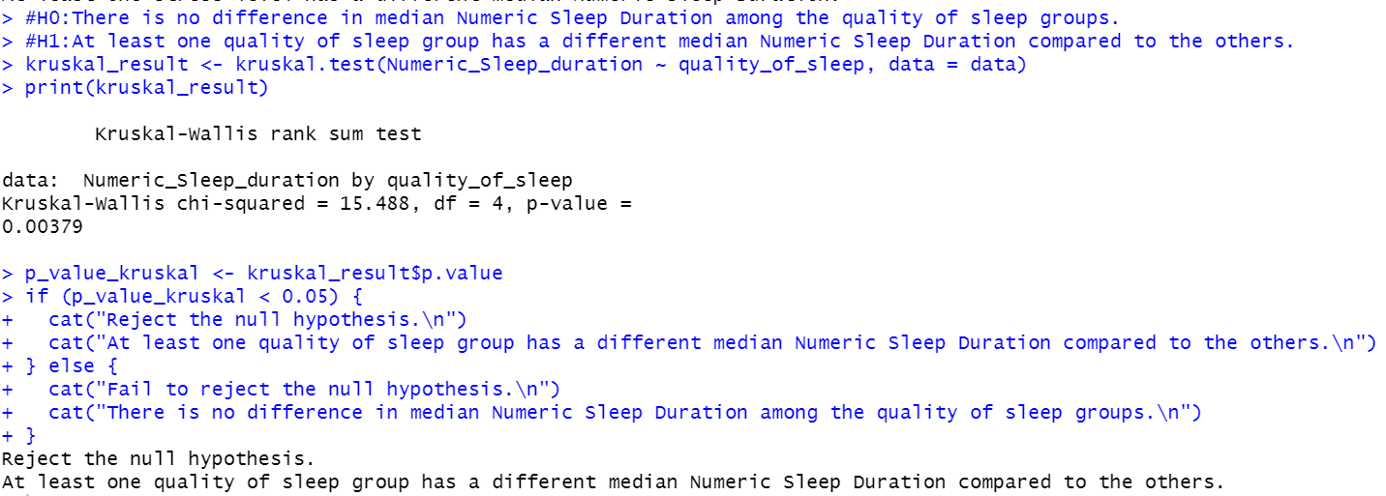
Kruskal-Wallis Test
Null Hypothesis : There is no difference in median Numeric Sleep Duration among the quality of sleep groups.
Alternate Hypothesis : At least one quality of sleep group has a different median Numeric Sleep Duration compared to the others.
LOS = 5%
P-value < 0.05
We, reject null hypothesis.
Conclusion: At least one quality of sleep group has a different median Numeric Sleep Duration compared to the others.

Slide 16
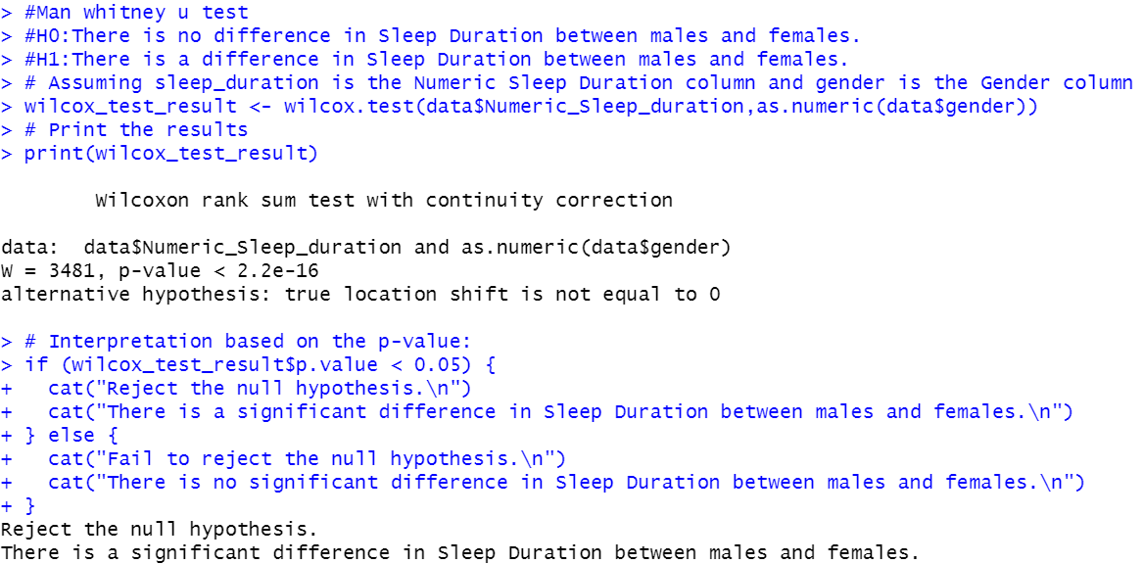
Mann-Whitney U Test
Null Hypothesis : There is no difference in Sleep Duration between males and females.
Alternate Hypothesis : There is a difference in Sleep Duration between males and females.
LOS = 5%
P-value < 0.05
We, reject null hypothesis.
Conclusion: There is a difference in Sleep Duration between males and females.

Slide 17
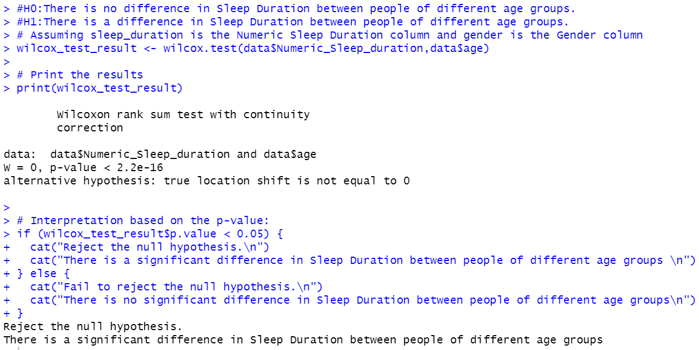
Mann-Whitney U Test
Null Hypothesis : There is no difference in Sleep Duration between people of different age groups.
Alternate Hypothesis : There is a difference in Sleep Duration between people of different age groups.
LOS = 5%
P-value < 0.05
We, reject null hypothesis.
Conclusion: There is a difference in Sleep Duration between people of different age groups.

Slide 18
Conclusion
Frequency of wake up during the night
Which factors have an association with the sleep duration ?
Frequency of wake up during the night
Sleep duration
Sleep disorder
Caffeine before sleep
Emotional state before bedtime
Work schedule
Quality of sleep
Sleep disorder
Stress levels
Caffeine before sleep
Frequency of caffeine consumption before sleep
Consistent bedtime routine
Which factors have an association with the quality of sleep ?

Slide 19
Conclusion
With changes, does age groups have different sleep duration ?
There is a difference in Sleep Duration between people of different age groups.
Does stress level have an impact on sleep duration ?
Sleep duration changes according to gender?
There is a difference in Sleep Duration between males and females.
Median sleep duration for different types of stress level are equal.

Slide 20
Thank Y0u

